Slide 1
Local grocery store

Slide 2
Planning of local grocery website
Purpose of website:
Creating a grocery store website means making a special place for the store on the internet. It's like a virtual store where people can buy groceries online. This way, the store can reach more customers and be open all the time, even when the physical store is closed.
On the website, customers can see pictures and descriptions of the products the store sells. They can add the items that they want to a virtual cart and then pay for everything online. It's like shopping from home.
Having a website is like having an online version of the store. It makes shopping more convenient for customers and helps the store grow its business by reaching more people.

Slide 3
Target audience:
Local residents who want to buy groceries without going to the store.
Older adults who are not able to go out and find it easier to shop online.
People who like using technology and prefer online shopping.
Busy individuals who don't have time to visit the store in person.
Those who look for good deals and discounts while shopping.
Customers who have already visited the store and want to keep buying from there.
Tourists visiting the area who need groceries during their stay.
People who are health-conscious and want specific products.
Those living in remote areas who can't easily visit the store.

Slide 4
Multiplatform Display
The goal of multiplatform display is to make sure that the viewer can easily navigate, read, and interact with the site, whether they are using a desktop computer, a tablet, or a mobile phone.
Mobile Phones: When someone visits the grocery store website from a mobile phones the content should fit the smaller screen. Navigation menus may turn into a "hamburger" icon, and images and text should be easily readable without the need to zoom in.
Tablet: For tablet devices, the website should adjust its layout to fit the screen properly by using responsive design techniques. This could involve arranging content in a vertical manner, and the navigation menu might transform into a compact icon that can be expanded for easier interaction using touch.
Desktop and Laptop: When someone visits the grocery store website from a desktop or laptop computer, the website layout and design adjust to take advantage of the larger screen space. Images and content might be displayed side by side, and navigation menus can be more comprehensive.

Slide 5
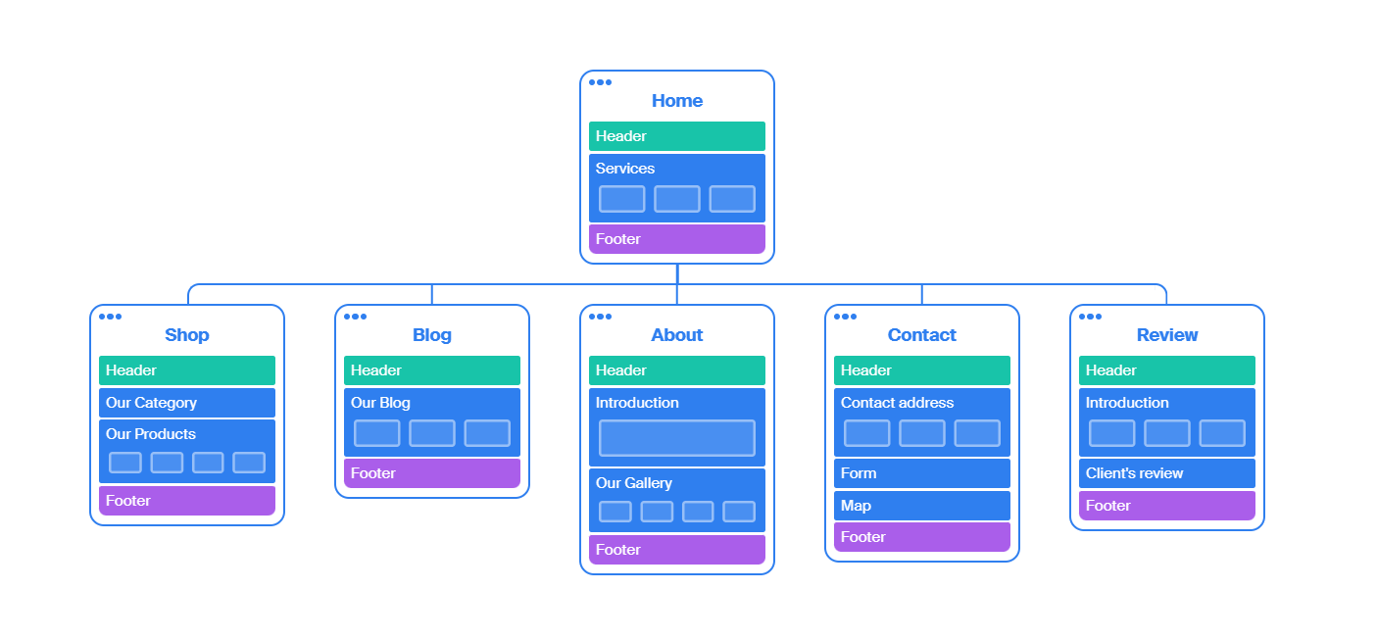
SITE map

Slide 6
WIREFRAME
A wireframe is like a blueprint for a website or app. It's a simple drawing that shows where different things will go on the screen, like buttons, pictures, and text. It helps designers and developers plan how everything will look and work before they start building the real thing. Wireframes are like a map that guides them in creating a user-friendly and organized design.

Slide 7
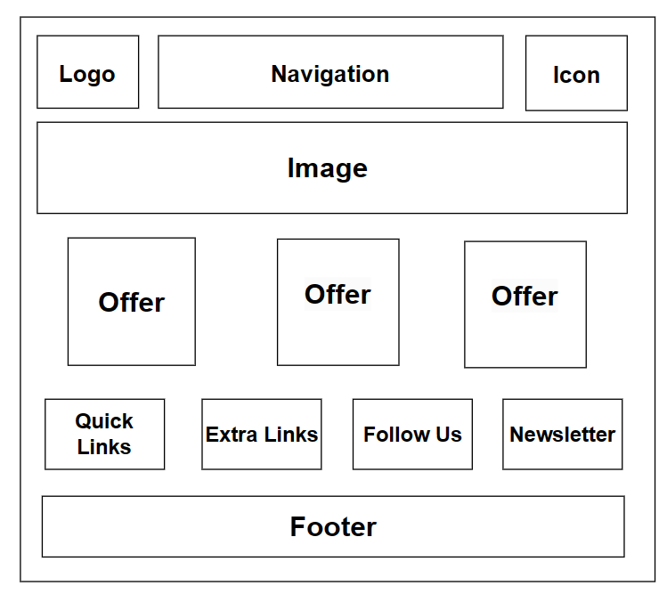
Wireframe of Home page

Slide 8
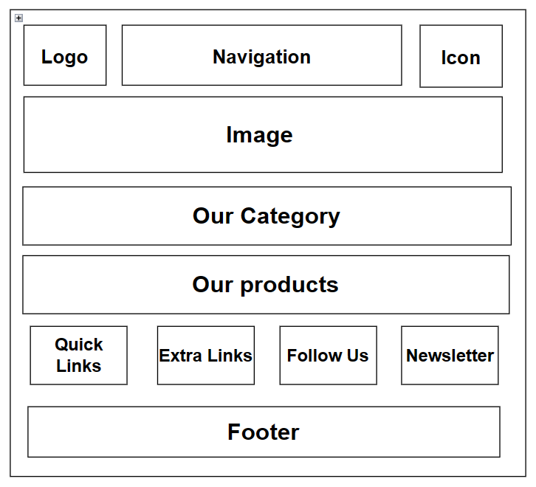
Wireframe of Shop page

Slide 9
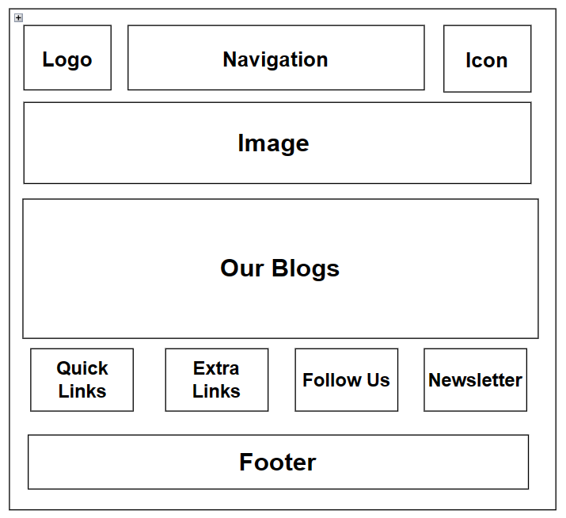
Wireframe of Blog page

Slide 10
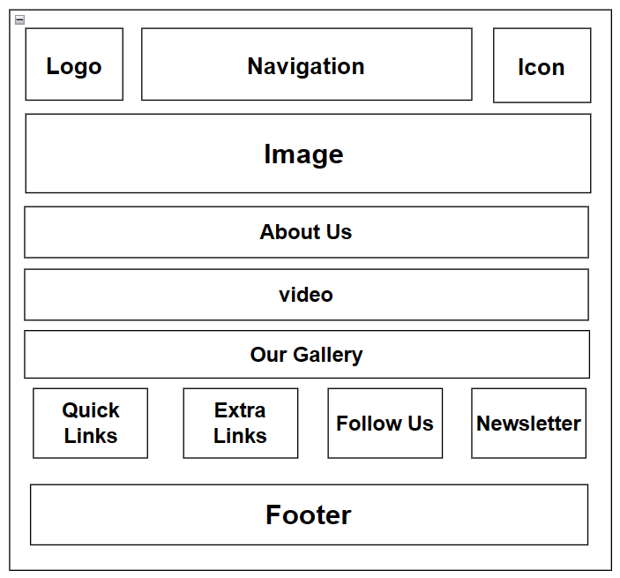
Wireframe of About page

Slide 11
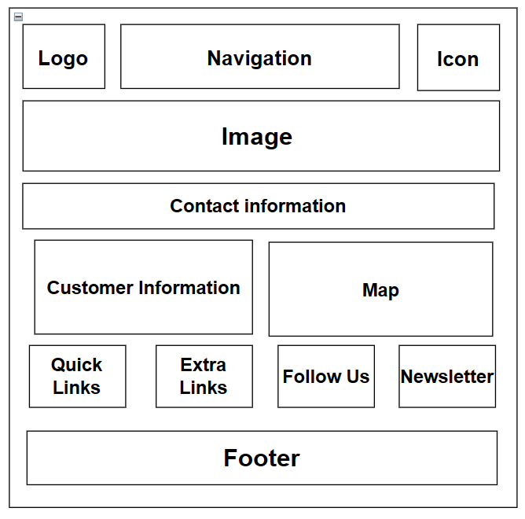
Wireframe of Contact page

Slide 12
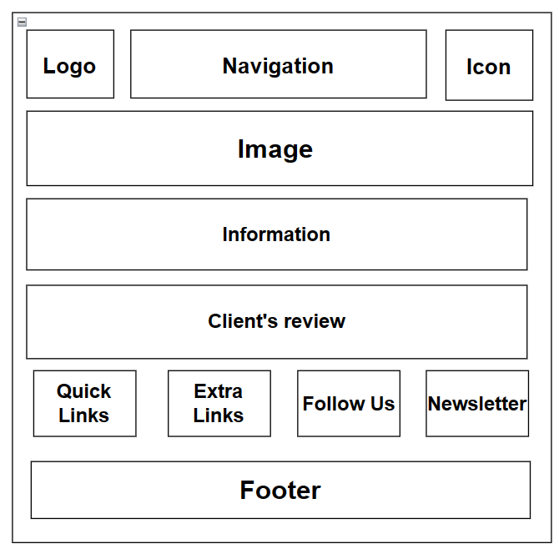
Wireframe of Review page

